Slide 1

Provide Insights to the Marketing
Team in Food & Beverage Industry
CodeX is a German beverage company that is aiming to make its mark in the Indian market. A few months ago, they launched their energy drink in 10 cities of India.
Their Marketing team is responsible for increasing brand awareness, market share, and product development. They conducted a survey in those 10 cities and received results
from 10k respondents. Peter Pandey, a marketing data analyst is tasked to convert these survey results to meaningful insights which the team can use to drive actions.

Slide 2
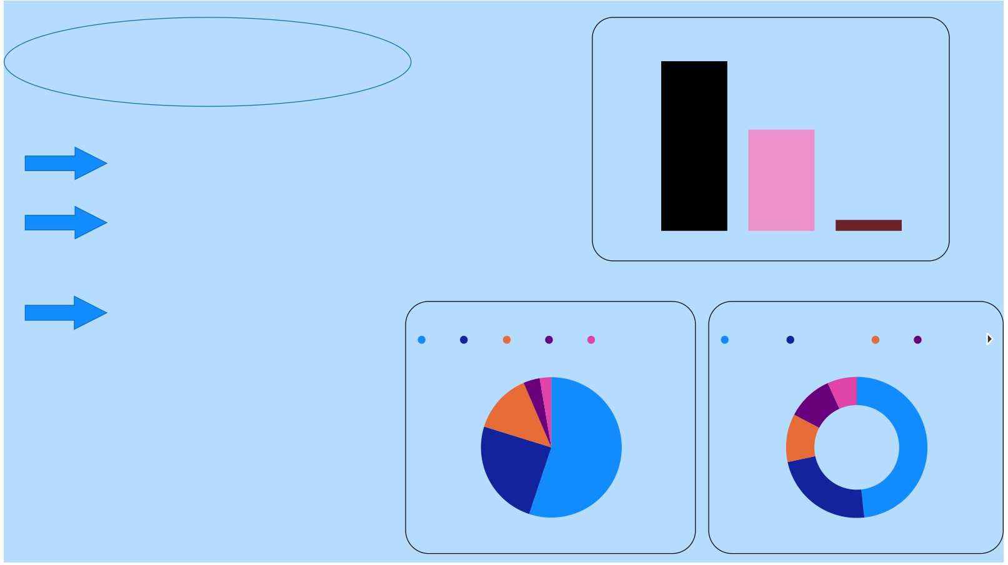
Energry Drink consume by Gender
600
590
400 352
Demographic Insights
Male Prefer more energy drink. As 60% of energy drink consumers are Male
Online ads are more ef icient for marketing
as adult where more addicted to social media
200
0
38
Non-binary
Male
Female
19-30 were the
major energy drinkers. As they were at there peak of life and
Energry Drink consume by Age
19-30 31-45 15-18 46-65 65+
Top Marketing_channels
Online ads TV commerc… Other Outdoor …
wanted expression
they life in fullest where in there work or enjoyment.
may be they require more energy
7%
11%
11%
23%
14%
25%
55%
48%

Slide 3

Favorable Ingredients
Caffeine
Consumer Preferences
363
Vitamins 243
Caffeine gain more popular
among the energy drink. Maybe the
Sugar
219
caffeine relieve stress more efficient.
Most Packaging_preference
Most Packaging_preference Compact and portable cans
Guarana
Collectible pac…
155
412 Most people preferred to buy
285 Portable cans. may be it is easy to use and
throw. Most people preferred to buy Portable cans. may be it is easy to use and throw.
130
130.0
Eco-friendly d…
105
48
412.0
Innovative bottle design
Compa… Innovat… Collecti… Eco-fri… Other
and
portable
cans
bottle
design
packag…
design
105.0
Other
285.0 48.0

Slide 4
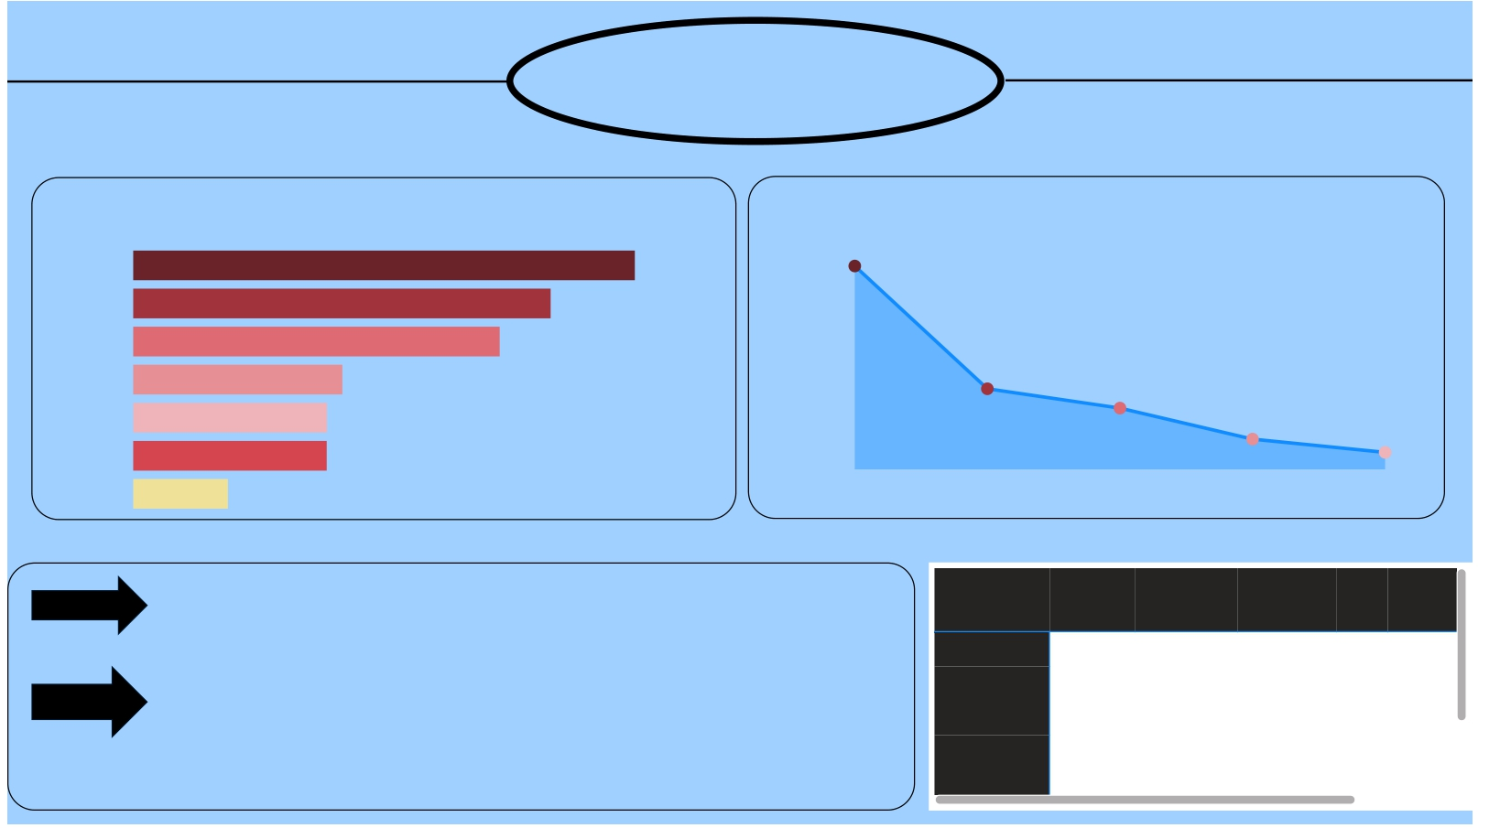
Compe on Analysis
Top Brand Reasons_for_choosing_brands
2652
Cola-Coka 2538
Bepsi 2112
Gangster 1854
Blue Bull 1058 2011 1910
CodeX
Sky 9
980
979
1748
1679
Others
479
Brand
reputation
Taste/ lavor
preference
Availability
Effectiveness
Other
Cola-Coka and Bepsi has large numbers of consumers. hence it
Current_brands
Availability Brand
reputation
Effectiveness Other Taste/flav
placed in top brands
The primary for buying those brands are due to their in luence
brand reputation they built over years

Bepsi Blue Bull CodeX
Cola-Coka
418 180 195 510
577 289 259 616
339 355
187 165
176 168
433 448
Gangster 339 511 338 309

Slide 5

Brand penetration
Brand percep on Taste experience
our brand has neural ra ng in any criteria. In Neutral Positive Negative 100%
Taste experience most of customer given 3 star and in Brand percep on users given neural reac on
3 4 5
286 248 191
18%
22% 60% 2 148
CodeX brand didn't leave any impression on customer
1
107
37.4%
Top City
Bangalore
Hyderabad Mumbai Chennai
Pune
Kolkata
Ahmedabad
Delhi
Jaipur
Lucknow
codeX brand doing very good at some major state like Banglore Hyderabad and Mumbai we can develop our product in that states.
States like Delhi Jaipur and Lucknow doing very bad process we need to focus in these states and maybe be can introduce some offers and adver se in these areas

Slide 6

Purchase behavior
Top Purchase_loca on
Supermarkets
Online retailers
Gyms and itness centers
Local stores
Other
most of customer buys energy drink from Supermarket
maybe super market is easy for access the customer
supermarket maybe convenient for the customer to shop then any other plaform
most of customer drink when they are doing Sports/Exercise.
maybe while exercise they loses more energy to do full ill that lost energy they need suppliments
Typical_consumption_situations
Sports/exercise Studying/working late Social outings/parties Other Driving/commuting
450 320 128 60 22

Slide 7

factors In luence respondent's purchases
deisions
Purchased by Price
Purchased by limited_edition_packaging
Price play a major role in decision in buying a brand. As the pie chat show 43% buy if the
50-99 100-150 Above 150 Below 50
No Yes Not Sure
price is below 100 as the price increase the buyers decreased
limited package shown no effect for decision
10%
20%
16%
43%
40%
of buying the brand
Consume_reason
Increase Decrease Total
31%
39%
Ul mate decision of buying the brand come from the brand influence and taste there the major role in buying brand
Brand reputation
Taste/flavor
preference
Availability
Effectiveness
Other
Total

Slide 8

Product Development
Top Reasons_for_choosing_brands
Brand reputation
Taste/ lavor preference
Availability
Effectiveness
Other
2652
As the statics show most customer buy the product based on Brand Reputation.
Codex should be focused on brand Reputation as most customer buy product on this ceritaria
2011
1910
1748
1679
 Help Q&A understand people better by adding synonyms. Add synonyms now 
 Ask a question about your data  
Try one of these to get started

Slide 9

Recommenda on
The Major focus should be brand improvement and taste because average ra ng of CodeX brand is 3-star
and taste quality is neural that shows CodeX brand didn't le any impression on audiences
CodeX has to limit there prices below 100rs has major of people will buy product if prices are below
100rs as the price increase the customers rate will dras cally decreases
The target audience will be adult male. Most of consumers on brand are adult male as they occupies 60%
of consent were adult.
online ads should be major marke ng campaigns as most of adult were addicted to social media and
online marke ng will be most beneficial and highly viewed
our major focus should be in majors ci es like Delhi and Lucknow it has least amount of customers may
be by realizing new offers and decreasing prices will give an effec ve result in thoes major states

